Slide 1
Using Node Server to Host Angular application

Slide 2
The problem
Angular has a built in convenience option that will serve your Angular application. Generally at http://localhost:4200
Each of the node based webservers we have used so far have been hosted from http://localhost:3000
Calling endpoints from a different origin will cause a Cross-origin resource sharing (CORS) issue.
An Origin is defined by a protocol (https, http), domain and port
http://localhost:4200 and http://localhost:3000 are different origins because they have a different port numbers.

Slide 3
What is CORS
Before CORS became standarized there was no way to call an API endpoint from a different origin for security reasons.
The Cross-Origin Resource Sharing (CORS) standard works by adding new HTTP headers that allow servers to describe the set of origins that are permitted to read that information using a web browser. (MDN WebDocs - https://developer.mozilla.org/en-US/docs/Web/HTTP/CORS )
This allows the server to define what origins are able to make requests on that server. By default browsers now sets a security policy that only allows access to requests from the same origin.

Slide 4
CORS
Cors prevents attackers from planting a script on a website that would make an ajax call to another site, maybe a banking site that you might happen to be logged into, and make a transaction using your credentials.
The bank would only allow ajax calls to come from its own sites. Cors allows them to define which of the sites they control, that can make calls to its endpoints.

Slide 5
Adding CORS to a Node Server
An npm package exists that provides Express middleware that will add CORS headers to requests.
npm install cors –save
Once installed you can add the following lines to your server code to enable all cors requests for all origins.
var cors = require('cors') //import the cors package.
app.use(cors()); // Add cors middleware to the express application
Configiration Options can be set to limit the servers that can access the endpoints from your server. Documentation is available on the NPM site.

Slide 6
Adding CORS to a Node Server
Once the cors middleware is installed an angular application run from http://localhost:4200 can access an endpoint from http://localhost:3000
You can continue to use the angular convenience server that host your site at localhost:4200 and have your node server running on port 3000.
This makes development a little easier as the angular app will rebuild each time you save a file.
nodemon is a NPM tool that will monitor the code of your server and rebuild and restart it when a file is saved, similar to the angular convenience server. Instead of calling node server.js to start your server you can use nodemon server.js.
Check the NPM site for installation instructions for this npm package.

Slide 7
Single Origin option
When the angular build cli command is used a optimised copy of the site is built in the /dist directory.
This directory can be setup as a source of static resources for the server.
The index.html file is the only html file in an angular application and will be served by default from a get request to the root level of the site.
By linking the built version of the angular app and the server we can host the angular application and the server endpoints from a single server.

Slide 8
Single origin - Structural Diagram
An angular application is a single page website (index.html). A request to the root of the site will return the index.html file (which is the application).
express.js
Web Client
(http://localhost:3000)
NodeJS Webserver
(server.js)
Request for http://localhost:3000
Body parser
Angular Application
Response returns the application
endpoint "/"
Maps to angular application
../dist/appname
index.html
endpoint "/api/auth"
Maps to a login check
Database

Slide 9
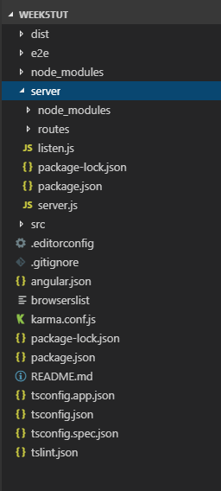
Project File Structure – With Server
The "dist" directory is created when you run ng build.
If you update your angular code you need to re-run ng build.
The server directory holds the nodejs code for your server.
The server project has its own node_modules and package.json file
We are creating two projects. A server and a front end. Each is managed with a package.json file to track its own dependencies.
The built version of the angular application needs to be used as the source for the server .
The angular project has its own node_modules and package.json file

Slide 10
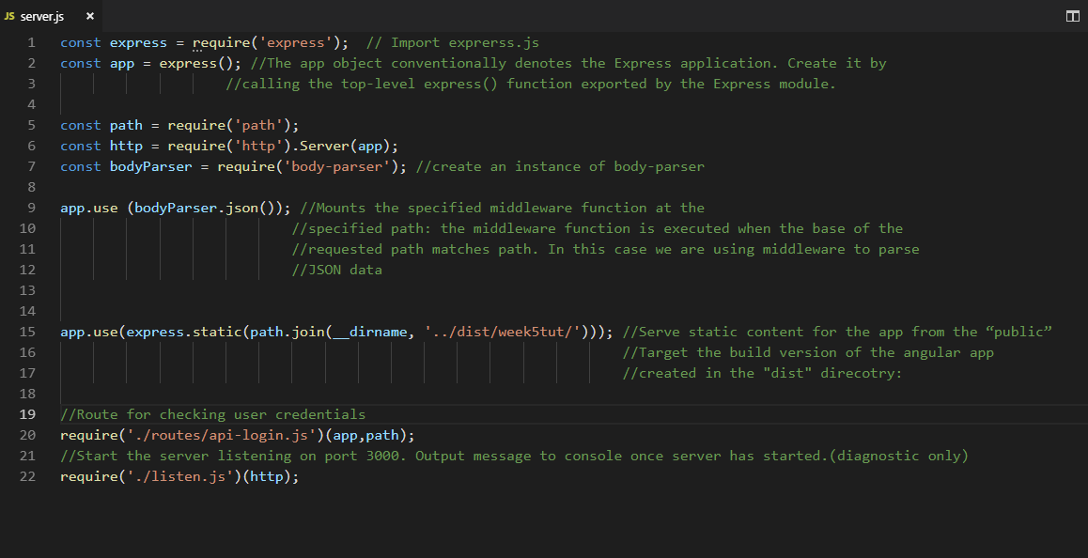
Code Sample
In week 3 we mapped the location of static files to a "www" directory to host our form.html file. We are doing the same thing here and pointing the static content directory to the location of our built angular application directory.
The path module helps in generating a link to the correct directory.
Note mapping to built version of angular application
Passing parameters to a module to be used in the module.

